Slide 1



ADVANCED ASSIGNMENT
Faturachman N
FSDA Barca Team 2

Slide 2

TABLE OF CONTENT
Data Dictionary
Business Overview
Analysis of question number 5
Analysis of question number 6

Slide 3
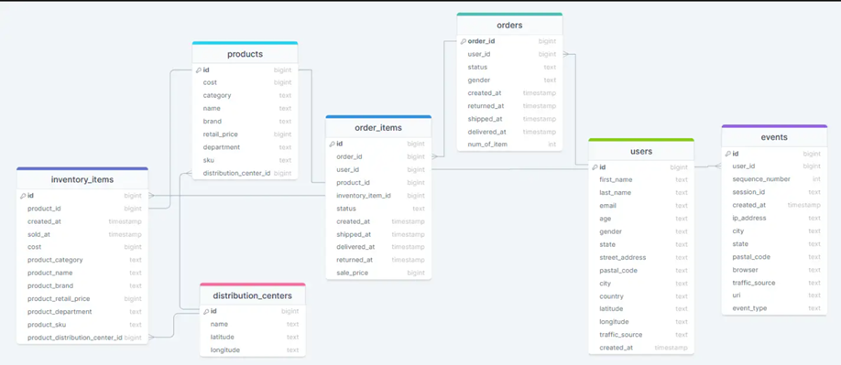

DATA DICTIONARY

Slide 4




Integrated E-commerce Platform: Manages users, orders, order items, and products for online sales.
Inventory & Distribution: Tracks product stock across multiple warehouses for efficient logistics.
BUSINESS OVERVIEW
Customer Insights: Captures user activities (e.g., product views, cart adds) for behavior analysis.

Slide 5
To support the business, find monthly growth of inventory in percentage breakdown by product categories, ordered by time descendingly. After analyzing the monthly growth, is there any interesting insight that we can get?

Slide 6
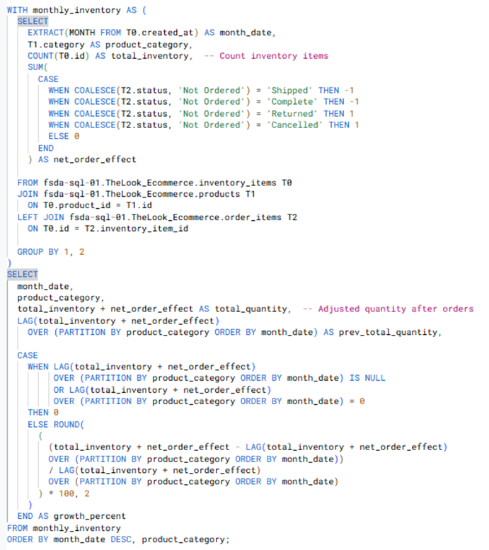
Link Untuk hasil Query

Slide 7
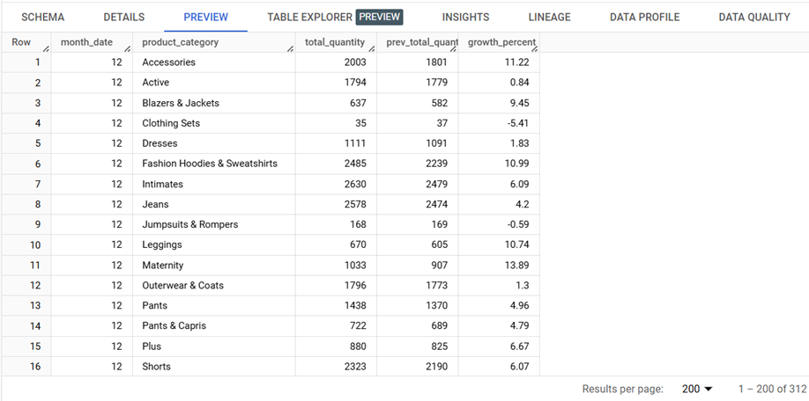
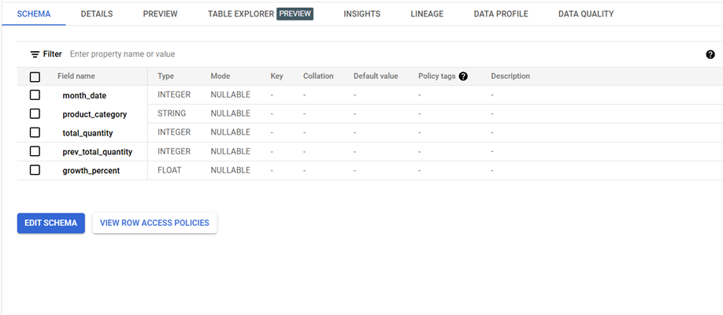
Link Untuk Table

Slide 8



AVERAGE PERCENTAGE GROWTH GRAPH
•Accessories: -1.19% per month
Jeans: -1.31% per month
•Dresses: -0.67% per month
•Suits: -1.98% per month
Blazers & Jackets: -1.80% per month

Slide 9
KEY FINDINGS FROM GROWTH TRENDS
Consistent Decline: Nearly all categories show a reduction in inventory turnover.
Categories with Lower Declines: Dresses experienced the smallest decline at -0.67% per month, indicating slight stability.
Highest Decline Categories: Suits, blazers & jackets, and jeans experienced the most significant drops, with growth rates ranging from -1.31% to -1.98% per month.
Possible Causes:
Changes in consumer demand
Overstocking issues
Lack of effective promotions

Slide 10
IMPLICATIONS OF DECLINING INVENTORY TURNOVER
FINANCIAL & OPERATIONAL RISKS
SUPPLY CHAIN MANAGEMENT CHALLENGES
MARKET INSIGHTS & CONSUMER BEHAVIOR
Excess stock increases storage costs
Risk of product obsolescence or expiration
Inefficiencies in cash flow
Shifts in customer preferences
Competitive activity
Need for dynamic pricing and promotions
Inefficient stock management
Issues with suppliers

Slide 11

MAIN FINDINGS FROM THE ANALYSIS
PRIMARY FOCUS OF RECOMMENDED STRATEGIES
VISION
Overall decline in inventory turnover
Risks involved: Overstocking, increased storage costs, product obsolescence, and cash flow inefficiencies
Potential causes: Changing customer preferences, ineffective promotions, and suboptimal inventory strategies
Optimize Inventory Management
Enhance Marketing Strategies
Improve Supply Chain Coordination

Slide 12
Create monthly retention cohorts (the groups, or cohorts, can be defined based upon the date that a user completely purchased a product) and then how many of them (%) coming back for the following
months in 2022. After analyzing the retention cohort, is there any interesting insight that we can get? (Skillset: Intermediate SQL & Advanced SQL)

Slide 13
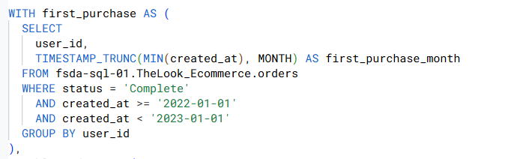
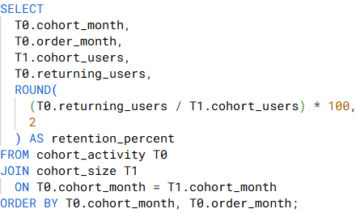
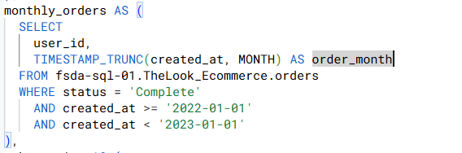
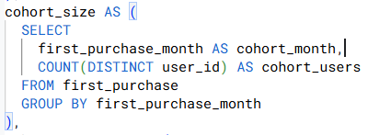
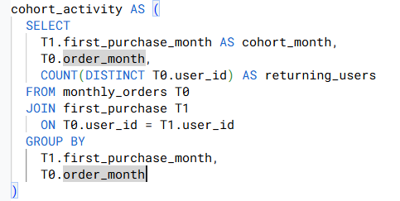
Link Untuk hasil Query

Slide 14
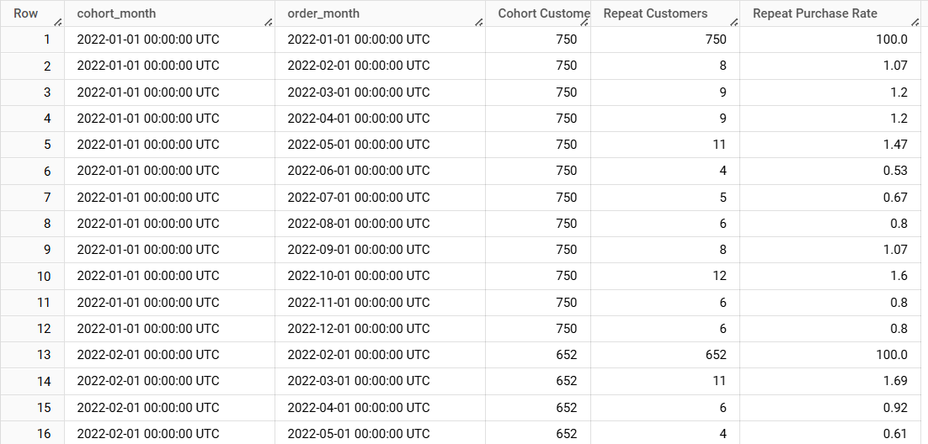
Link Untuk hasil Query

Slide 15
DATA OVERVIEW
✅ Cohort Month – First purchase month of the customer
✅ Order Month – Month of subsequent purchases
✅ Cohort Customers – New customers in the cohort month
✅ Repeat Customers – Customers who made additional purchases
✅ Repeat Purchase Rate – Percentage of returning customers

Slide 16
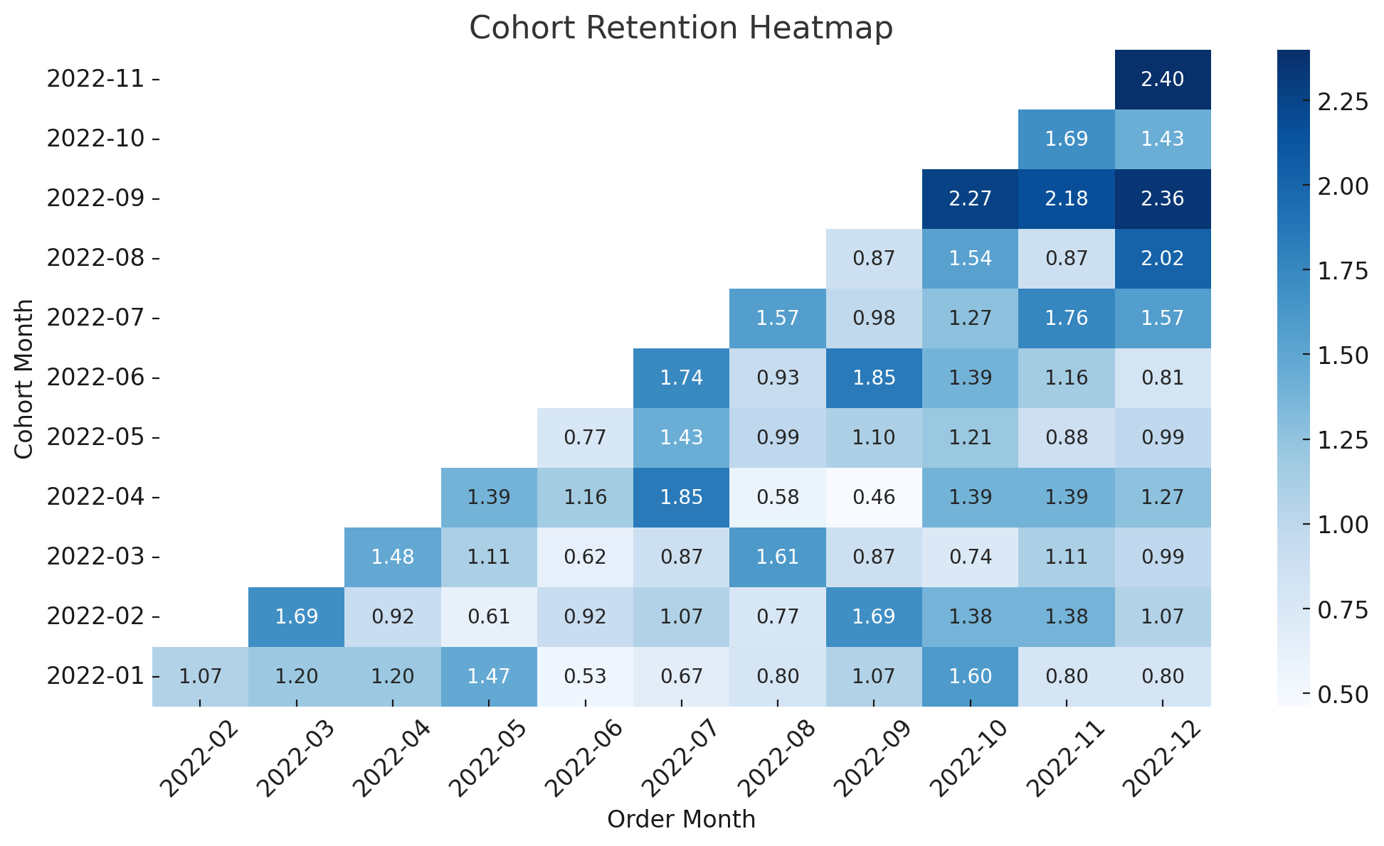
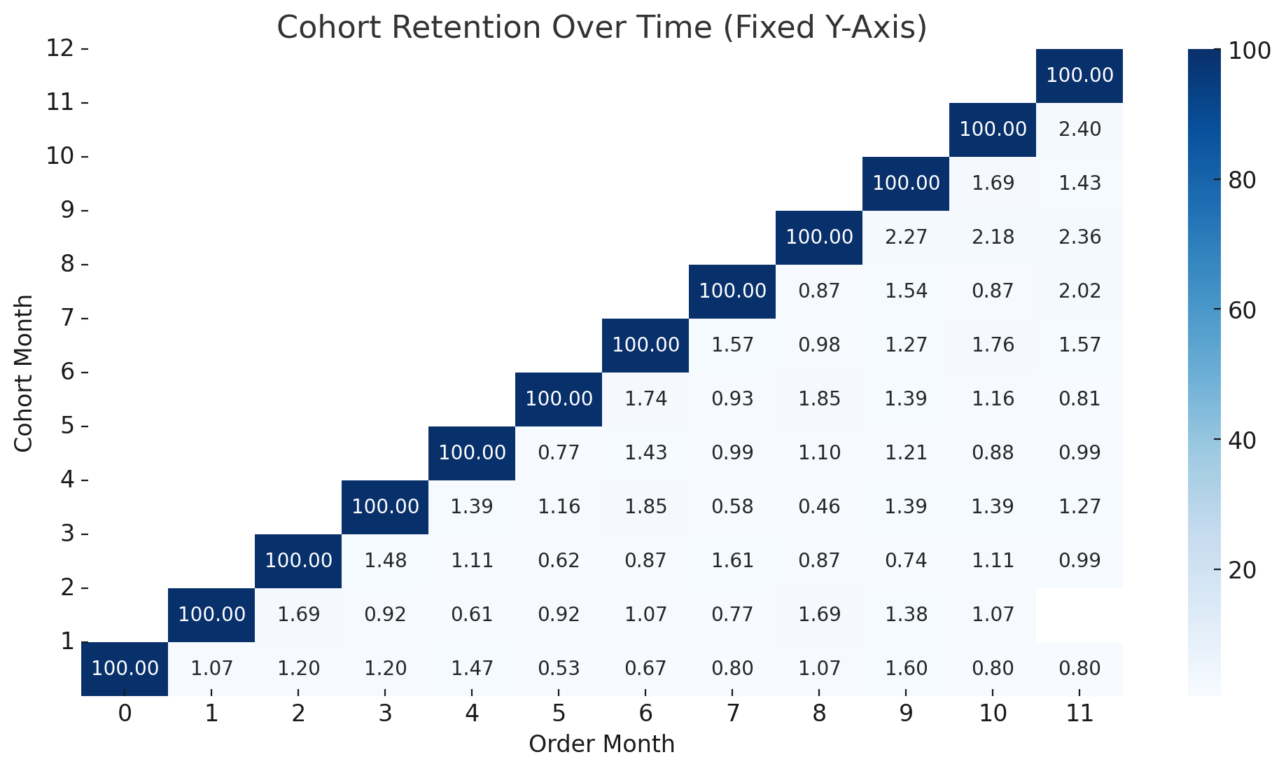
Retention naturally declines over time, a common pattern in e-commerce.
Some cohorts have significantly better retention, indicating successful engagement strategies.
BUSINESS OVERVIEW

Slide 17
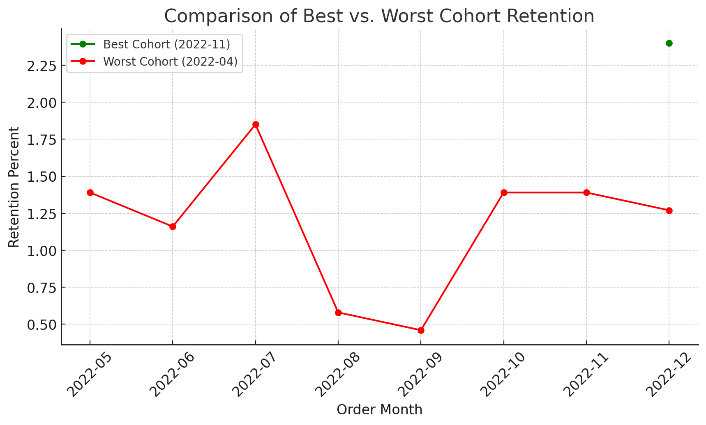
The best-performing cohortsBest Cohort: November 2022 → December 2022 (2.4% retention).
This cohort shows strong retention, possibly due to seasonal sales (11.11, Black Friday) or effective promotions.
Worst Cohort: April 2022 → September 2022 (0.46% retention).
A sharp drop suggests issues with customer engagement, promotions, or product relevance.
BUSINESS OVERVIEW

Slide 18
FACTORS AFFECTING RETENTION
THE NUMBER OF INITIAL CUSTOMERS HAS LITTLE IMPACT
ADDITIONAL INFLUENCING FACTORS:
STABILITY OF REPEAT CUSTOMERS HAS A SIGNIFICANT IMPACT
Strong correlation (~0.93) between stable repeat customers and overall retention
Customers who repurchase within the first few months are more likely to continue purchasing
Product category (e.g., daily essentials have higher retention than luxury items)
Time between the first and second purchase (the shorter, the higher the retention)
Weak correlation (~0.29) between cohort size and repeat purchase rate

Slide 19
KEY TAKEAWAYS
Most customers do not return after the first purchase, highlighting the need for better post-purchase engagement.
Cohorts acquired during promotional periods often have higher retention rates, but only if the promotions attract quality customers.
Consistently returning customers lead to stronger retention, meaning strategies should focus on habitual purchasing behavior.
Product category, time between purchases, and customer experience significantly influence retention.

Slide 20
RECOMMENDATION
Post-Purchase Engagement:
Send follow-up emails with personalized product recommendations.
Offer exclusive discounts on second purchases.
Retention-Focused Promotions:
Instead of one-time discounts, implement loyalty programs or subscription models to encourage repeated purchases.
Optimize the First Purchase Experience:
Provide fast delivery and seamless checkout.
Ensure high-quality packaging and customer service.
Encouraging Habitual Shopping Behavior:
Create targeted reminder campaigns for customers who haven’t returned in a while.
Offer incentives for frequent purchases (e.g., free shipping on every third order).

Slide 21
CONCLUSION
This analysis highlights that retaining customers in e-commerce is more challenging than acquiring them, making post-purchase engagement a critical factor. By understanding which factors drive repeat purchases, businesses can develop targeted strategies to improve retention and maximize long-term revenue.

Slide 22
THANK YOU

